Slide 1
Creating an
ISOTYPE MATRIX

Slide 2
As a member of the media, I need to communicate the importance of this issue to the public and would like to highlight preventability.

Slide 3
There are multiple ways to design for
this user story.
Simple charts, like a bar or donut chart, are clear and emphasize the preventable deaths. An isotype matrix adds a visual cue that the data represented are people, and, specifically, women.
Preventable | Not preventable
Pregnant at time of death
Death within
365 days of pregnancy

Slide 4
1. Select icons to represent the data.
Be mindful of how the icons could be misinterpreted, and when in doubt ask for feedback.
Here, we use three icons
a pregnant woman to represent deaths while pregnant
two icons (with and without a baby) to represent deaths in the post-partum period, as not all deaths are among women who had live births

Slide 5
Icons can be easily inserted directly
in Powerpoint.
Use the Insert > Illustrations > Icon button on the ribbon, as illustrated above.
Alternately, for more unique icons, use a source like The Noun Project. Ensure you attribute the creator if required.
TIP
Crop excess white space from the icon to avoid overlapping shapes that can be frustrating to maneuver

Slide 6
2. Build your icon array in grayscale
Consider the count of each icon if different icons have different meaning.
Add a shape legend if using multiple icons; may not be necessary if the headline clearly states what the icon represents if using only one repeating shape.
Consider where the final product will be published when determining the shape of your icon array.

Slide 7
3. Color your icons.
Color the icons based on the proportions represented in your dataset.
Basic
Ensure adequate contrast between your colors – try the simulator on WebAIM.org to test the contrast.

Slide 8
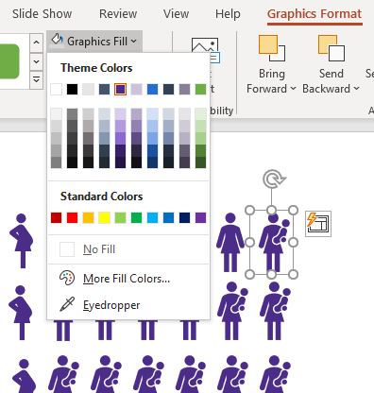
Solid icons can be easily recolored
in Powerpoint.
Click on the icon (or select multiple). Use the Graphics Format > Graphics Fill button on the ribbon, as illustrated at left. Select the color of your choosing.
TIP
The colors available to you will be those in your Slide Master. To change the color options available, change the default colors in the View > Slide Master > Background > Colors ribbon.

Slide 9
Preventable | Not preventable
4. Add identifying information.
Ensure you have a color legend telling the reader what the colors represent.
Add and label a shape legend, if required.
Add a headline or key takeaway.
Pregnant at time of death
Death within
365 days of pregnancy

